Slide 1
Condition execution
If statement
If else statement
If..elif..else statement
Nested if
Range() function
Enumerate function
For loop
For loop with else
While loop
While loop with else
Break
Continue
Pass

Slide 2
if Statement Syntax
EXAMPLE:
a=int(input('Enter the First number'))
b=int(input('Enter the second number'))
if a>b:
print("A is big")
if b>a:
print("B is big")
SYNTAX:
if test expression:
statement(s)

Slide 3
Start and stop
Var dec
statements
Condition

Slide 4
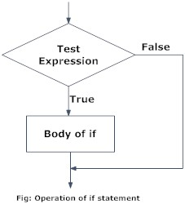
FLOW CHART:

Slide 5
if...else Statement
_{EXAMPLE:}
num = 3
if num >= 0:
print("Positive or Zero")
else:
print("Negative number")
SYNTAX
if test expression:
Body of if
else:
Body of else

Slide 6
if...elif...else Statement
if test expression:
Body of if elif test expression:
Body of elif else:
Body of else

Slide 7
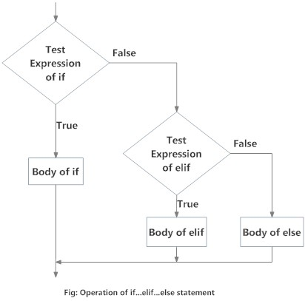

Slide 8
Example:
num = 3.4
if num > 0:
print("Positive number")
elif num == 0:
print("Zero")
else:
print("Negative number")

Slide 9
Nested if statements
NESTED IF EXAMPLE
n = float(input("Enter a number: "))
if n >= 0:
if n == 0:
print("Zero")
else:
print("Positive number")
else:
print("Negative number")

Slide 10
How to Clear the screen in Python prompt?
>>>from os import system
>>>system(“cls”)
or
>>>print(“\n”*30)

Slide 11
The range() function
We can generate a sequence of numbers using range() function. range(10) will generate numbers from 0 to 9(10 numbers).
We can also define the start, stop and step size as range(start,stop,step size). step size defaults to 1 if not provided.
EXAMPLE:
>>>print range(10)
[0,1,2,3,4,5,6,7,8,9]
>>>print range(5,50,5)
[5,10,15,20,25,30,35,40,45]

Slide 12
EXAMPLE FOR RANGE() FUNCTION:
Create a >>>x=range(3,6)
for n in x:
print(n)
>>>x
[3,4,5]
sequence of numbers from 3 to 19, but increment by 2 instead of 1:
x = range(3, 20, 2) for n in x: print(n)

Slide 13
ENUMERATE()
The enumerate() method adds counter to an iterable and returns it. The returned object is a enumerate object.
EXAMPLE:
for i,txt in enumerate([“Nandhini",“Ishwarya",“Pugazhini"]):
print(i,"th position value=",txt)
Output:
(0, 'th position value=', ‘Nandhini')
(1, 'th position value=', ‘Ishwarya')
(2, 'th position value=', ‘Pugazhini')

Slide 14
FOR LOOP
The for loop in Python is used to iterate over a sequence (list, tuple, string) or other iterable objects. Iterating over a sequence is called traversal.
Syntax of for Loop
for val in sequence:
Body of for

Slide 15
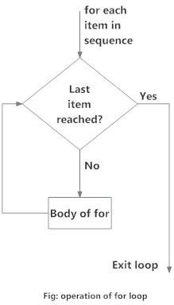

Slide 16
# PROGRAM TO FIND THE SUM OF ALL NUMBERS STORED IN A LIST
# LIST OF NUMBERS
numbers = [6, 5, 3, 8, 4, 2, 5, 4, 11]
# VARIABLE TO STORE THE SUM
sum = 0
# ITERATE OVER THE LIST
for val in numbers:
sum = sum+val
# OUTPUT: The sum is 48
print("The sum is", sum)
OUTPUT:
('The sum is', 48)

Slide 17
FOR LOOP WITH ELSE
A for loop can have an optional else block as well. The else part is executed if the items in the sequence used in for loop exhausts.
break statement can be used to stop a for loop. In such case, the else part is ignored.
EXAMPLE:
digits = [0, 1, 5]
for i in digits:
print(i)
else:
print("No items left.")
OUTPUT:
0
1
5
No items left.

Slide 18
WHILE LOOP STRUCTURE
SYNTAX OF WHILE LOOP:
while test_expression:
Body of while
In while loop, test expression is checked first. The body of the loop is entered only if the test_expression evaluates to True. After one iteration, the test expression is checked again. This process continues until the test_expression evaluates to False.

Slide 19
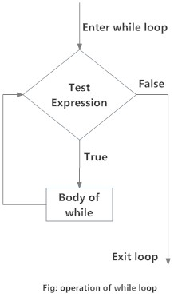

Slide 20
EXAMPLE:
n = 10
# INITIALIZE SUM AND COUNTER
sum = 0
i = 1
while i <= n:
sum = sum + i
i = i+1 # update counter
# PRINT THE SUM
print("The sum is", sum)
OUTPUT:
Enter n: 10
The sum is 55

Slide 21
WHILE LOOP WITH ELSE
Same as that of for loop, we can have an optional else block with while loop as well.
The else part is executed if the condition in the while loop evaluates to False.
The while loop can be terminated with a break statement. In such case, the else part is ignored. Hence, a while loop's else part runs if no break occurs and the condition is false.
EXAMPLE:
counter = 0
while counter < 3:
print("Inside loop")
counter = counter + 1
else:
print("Inside else")
OUTPUT:
Inside loop
Inside loop
Inside loop
Inside else

Slide 22
PYTHON BREAK STATEMENT
The break statement terminates the loop containing it. Control of the program flows to the statement immediately after the body of the loop.
Syntax of break
Break

Slide 23
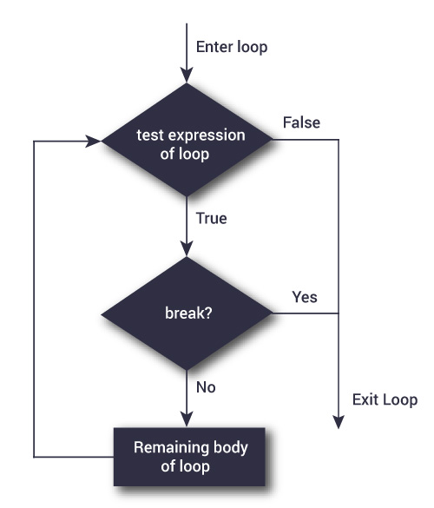

Slide 24
for val in “string”:
if val == "i":
break
print(val)
print("The end")
OUTPUT:
s
t
r
The end

Slide 25
PYTHON CONTINUE STATEMENT
The continue statement is used to skip the rest of the code inside a loop for the current iteration only. Loop does not terminate but continues on with the next iteration.
Syntax of Continue
Continue

Slide 26
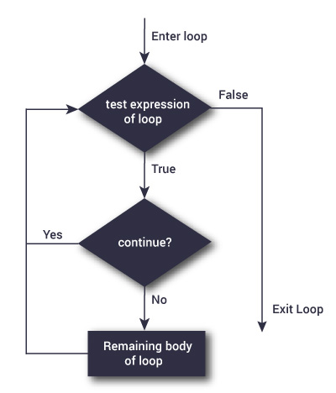

Slide 27
FOR VAL IN "STRING":
if val == "i":
continue
print(val)
print("The end")
OUTPUT:
s
t
r
n
g
The end

Slide 28
PASS STATEMENT
In Python, the pass keyword is used to execute nothing; it means, when we don't want to execute code, the pass can be used to execute empty. It is the same as the name refers to. It just makes the control to pass by without executing any code. If we want to bypass any code pass statement can be used.
It is beneficial when a statement is required syntactically, but we want we don't want to execute or execute it later. The difference between the comments and pass is that, comments are entirely ignored by the Python interpreter, where the pass statement is not ignored.
Suppose we have a loop, and we do not want to execute right this moment, but we will execute in the future. Here we can use the pass.

Slide 29
Example -1 Pass statement
# pass is just a placeholder for
# we will adde functionality later.
values = {'P', 'y', 't', 'h','o','n'}
for val in values:
pass
Example - 2:
for i in [1,2,3,4,5]:
if(i==4):
pass
print("This is pass block",i)
print(i)
Output:
1
2
3
This is pass block 4
4
5

Slide 30
RULES FOR FRAMING A FUNCTION:
Keyword def marks the start of function header.
A function name to uniquely identify it. Function naming follows the same rules of writing identifiers in Python.
Parameters (arguments) through which we pass values to a function. They are optional.
A colon (:) to mark the end of function header.
Optional documentation string (docstring) to describe what the function does.
One or more valid python statements that make up the function body. Statements must have same indentation level (usually 4 spaces).
An optional return statement to return a value from the function.

Slide 31
Functions in python
Definition of function:
In Python, function is a group of related statements that perform a specific task.
Functions help break our program into smaller and modular chunks. As our program grows larger and larger, functions make it more organized and manageable.
Furthermore, it avoids repetition and makes code reusable.
Syntax of Function
def function_name(parameters):
"""docstring"""
statement(s)
Docstring
The first string after the function header is called the docstring and is short for documentation string. It is used to explain in brief, what a function does.

Slide 32
Function Definition:
def fun(name):
"""This function welcomes to the person passed in as parameter"""
print("Hello,"+name+"Good morning")
Function Calling:
>>> fun("shahidha")
Hello,shahidhaGood morning
Calling doc_string:
>>> print(fun.__doc__)
This function welcomes to the person passed in as parameter

Slide 33
THE RETURN STATEMENT
The return statement is used to exit a function and go back to the place from where it was called.
Syntax of return
return [expression_list]
EXAMPLE:
def absolute_value(num):
"""This function returns the absolute
value of the entered number"""
if num >= 0:
return num
else:
return -num
# OUTPUT: 2
print(absolute_value(2))
# OUTPUT: 4
print(absolute_value(-4))

Slide 34
SCOPE AND LIFETIME OF VARIABLES
Scope of a variable is the portion of a program where the variable is recognized. Parameters and variables defined inside a function is not visible from outside. Hence, they have a local scope.
Lifetime of a variable is the period throughout which the variable exits in the memory. The lifetime of variables inside a function is as long as the function executes.
They are destroyed once we return from the function. Hence, a function does not remember the value of a variable from its previous calls.

Slide 35
def my_func():
x = 10
print("Value inside function:",x)
x = 20
my_func()
print("Value outside function:",x)
OUTPUT:
('Value inside function:', 10)
('Value outside function:', 20)

Slide 36
USER-DEFINED FUNCTIONS
Functions that we define ourselves to do certain specific task are referred as user-defined functions.
The way in which we define and call functions in Python are already discussed.
Functions that readily come with Python are called built-in functions. If we use functions written by others in the form of library, it can be termed as library functions.
All the other functions that we write on our own fall under user-defined functions. So, our user-defined function could be a library function to someone else.

Slide 37
ADVANTAGES OF USER-DEFINED FUNCTIONS
User-defined functions help to decompose a large program into small segments which makes program easy to understand, maintain and debug.
If repeated code occurs in a program. Function can be used to include those codes and execute when needed by calling that function.
Programmers working on large project can divide the workload by making different functions.

Slide 38
EXAMPLE OF A USER-DEFINED FUNCTION
def add_numbers(x,y):
sum = x + y
return sum
num1 = 5
num2 = 6
print("The sum is", add_numbers(num1, num2))
OUTPUT:
('The sum is', 11)

Slide 39
ARGUMENTS
In user-defined function topic, we learned about defining a function and calling it. Otherwise, the function call will result into an error.
Example. def func(name,msg):
"""This function greets to
the person with the provided message"""
print("Hello",name + ', ' + msg)
func("Monica","Good morning!")
>>> func("Monica") # only one argument
TypeError: greet() missing 1 required positional argument: 'msg‘
>>> greet() # no arguments
TypeError: greet() missing 2 required positional arguments: 'name' and 'msg'

Slide 40
PYTHON DEFAULT ARGUMENTS
def fun(name, msg = "Good morning!"):
"""
This function greets to
the person with the
provided message.
If message is not provided,
it defaults to "Good
morning!"
"""
print("Hello",name + ', ' + msg)
fun("shahidha")
fun("shahidha","How do you do?")
OUTPUT:
('Hello', 'shahidha, Good morning!')
('Hello', 'shahidha, How do you do?')

Slide 41
Arbitrary Arguments
def arb(*names):
"""This function greets all
the person in the names tuple."""
# names is a tuple with arguments
for name in names:
print("Hello",name)
arb("Monica","Lavanya","Shahidha","Sheela")
Output:
('Hello', 'Monica')
('Hello', 'Lavanya')
('Hello', 'Shahidha')
('Hello', 'Sheela')

Slide 42
To use *args and **kwargs in Python
The special syntax, *args and **kwargs in function definitions is used to pass a variable number of arguments to a function.
The single asterisk form(*args) is used to pass a non-keyworded, variable-length argument list.
The double asterisk form is used to pass keyworded, variable-length argument list. Here is an example of how to pass the non-keyworded form. This example passes one formal(positional) arguments and two more variable length arguments.

Slide 43
def test_variable(sstar, **dstar):
print("\n"*50)
print("formal arg: ",sstar)
for v in dstar:
print("another keyword arg: %s: %s") % (v,dstar[v])
test_variable(sstar=101, name="Ashok",sal=10000)
Output:
('formal arg: ', 101)
another keyword arg: name: Ashok
another keyword arg: sal: 10000

Slide 44
Function Overloading Example:
def a(x=None):
if x is None:
print("Who are you?")
else:
print("Hai hello")
a("Ashok")
a()
Output:
Hai hello
Who are you?

Slide 45
def sum(a,b=0,c=0):
if(b,c) is not (0):
print("Sum",a+b+c)
elif (c) is 0:
print("Sum",a+b)
else:
print("Sum",a)
sum(10,20,30)
sum(220,330)
sum(300)
Output:
('Sum', 60)
('Sum', 550)
('Sum', 300)

Slide 46
Recursive Function
Recursion is the process of defining something in terms of itself.
Example:
def calc_factorial(x):
"""This is a recursive function
to find the factorial of an integer"""
if x == 1:
return 1
else:
return (x * calc_factorial(x-1))
num = 4
print("The factorial of", num, "is", calc_factorial(num))
Output:
('The factorial of', 4, 'is', 24)

Slide 47
Lambda functions
In Python, anonymous function is a function that is defined without a name.
While normal functions are defined using the def keyword, in Python anonymous functions are defined using the lambda keyword.
Hence, anonymous functions are also called lambda functions.
Syntax of Lambda Function in python
lambda arguments: expression
Example:
double = lambda x: x * 2
#Output: 10
print(double(5))

Slide 48
How to import modules?
def jkaddition(x,y):
a=x+y
return(a)
def jksubtraction(x,y):
a=x-y
return(a)
def jkmultiplication(x,y):
a=x*y
return(a)
def jkdivision(x,y):
a=x/y
return(a)
Save the file name as jksample.
How to call from python prompt?
import jksample
>>> print jkmultiplication(4,5)
20
>>> print jkaddition(56,67)
113
>>> print jkdivision(9,3)
3

Slide 49
What are modules in Python?
Modules refer to a file containing Python statements and definitions.
Create a module and save it as a modules:
def add(a, b):
"""This program adds two
numbers and return the result"""
result = a + b
return result
Import modules:
>>> import modules
Using the module name we can access the function using the dot . operator.
>>> modules.add(45,56)
101

Slide 50
Python import statement:
import math
print("The value of pi is", math.pi)
Output:
('The value of pi is', 3.141592653589793)
Import with renaming
import math as m
print("The value of pi is", m.pi)
Output:
('The value of pi is', 3.141592653589793)

Slide 51
Python Module Search Path
>>> import sys
>>> sys.path
[‘E:/Nandhini/python', 'C:\\Python27\\Lib\\idlelib', 'C:\\Windows\\system32\\python27.zip', 'C:\\Python27\\DLLs', 'C:\\Python27\\lib', 'C:\\Python27\\lib\\plat-win', 'C:\\Python27\\lib\\lib-tk', 'C:\\Python27', 'C:\\Python27\\lib\\site-packages', 'C:\\Python27\\lib\\site-packages\\xlrd-1.2.0-py2.7.egg', 'C:\\Python27\\lib\\site-packages\\xlwt-1.3.0-py2.7.egg']

Slide 52
PROGRAMS FOR PRACTICE
Python program to add two numbers
Python Program for factorial of a number
Python Program for simple interest
Python Program for compound interest
Python Program to check Armstrong Number
Python Program for Fibonacci numbers
Python Program to Find the Square Root
Python Program to Calculate the Area of a Triangle
Python Program to Solve Quadratic Equation
Python Program to Swap Two Variables
Python Program to Check Leap Year
Python Program to Find the Largest Among Three Numbers
Python Program to Check Prime Number
Python Program to Check if a Number is Positive, Negative or 0
Python Program to Check if a Number is Odd or Even

Slide 53
1. Write a Python function to find the Max of three numbers.
2. Write a Python program to reverse a string.
3. Write a Python function to calculate the factorial of a number (a non-negative integer).
4. Write a Python function to check whether a number is in a given range.
5. Write a Python program to print the even numbers from a given list.
6. Write a Python function to check whether a number is perfect or not.
7. Write a Python function that checks whether a passed string is palindrome or not.
8.. Write a Python function to create and print a list where the values are square of numbers between 1 and 30 (both included).
9. Python Program to Display Calendar.
10. Python Program to Sort Words in Alphabetic Order.

